Slide 1



Slide 2
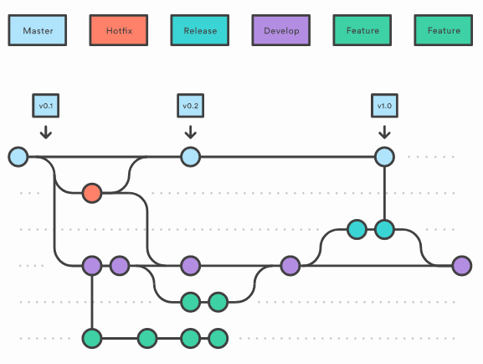

Slide 3
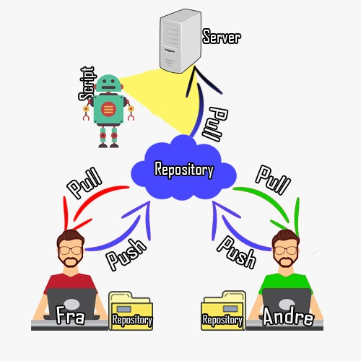

Slide 4
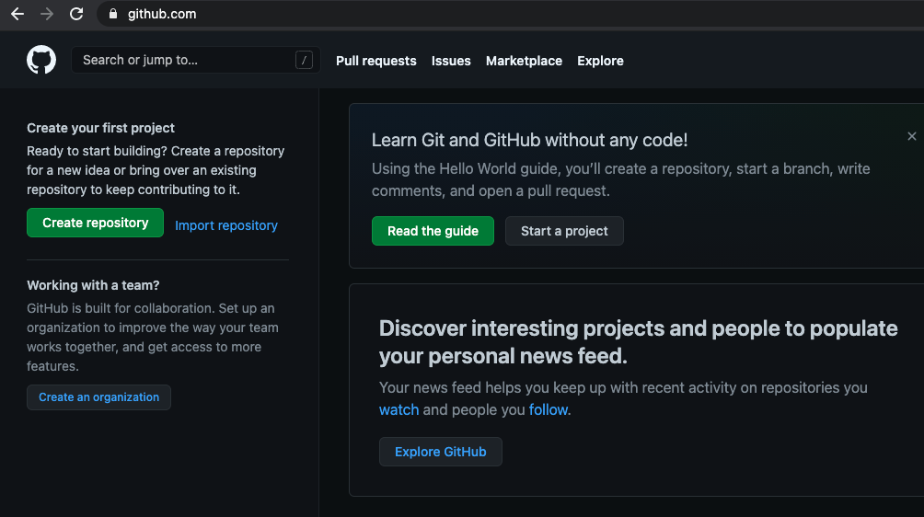

Slide 5
youngcoders2021@gmail.com AppleMusic_1
git config --global user.name ‘youngcoders2021’
git config --global user.email ‘youngcoders2021@gmail.com’
git config --global core.editor atom
cd *.* github/
echo ‘There is NO limit for dreamers \\nUnless you are NOT a dreamer!’ > textfile.txt
alias gits=‘git status’
touch .gitignore
textfile.txt
/pics
git config --global init.defaultBranch <anyName>

Slide 6
git branch <branch1>
git checkout <branch2>
echo ‘write in some new data!’ > newdata.txt
git status
branch2
ls –al
…
newdata.txt
…
Git checkout branch1
Ls –al
“
Git add .
List for branch1 and branch2 and show that the newdata.txt file is listed in both even after “git add .” command
git credential-osxkeychain erase
host=github.com
protocol=https

Slide 7
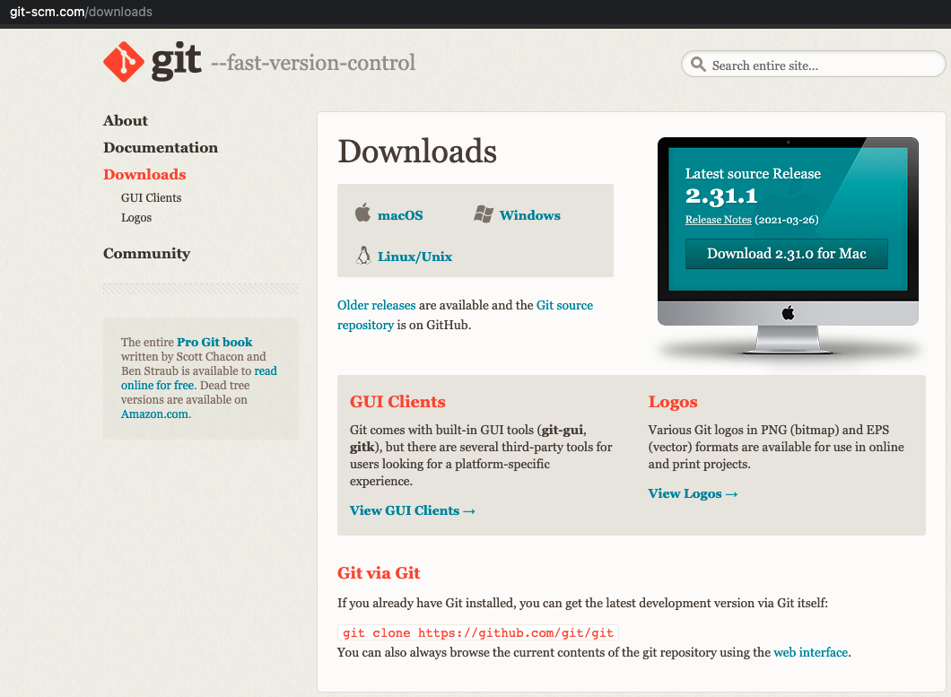

Slide 8
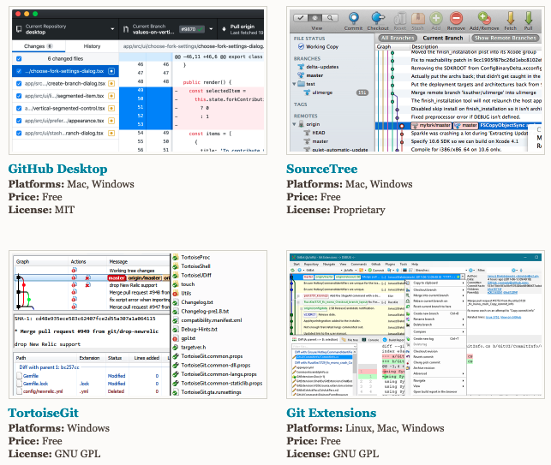
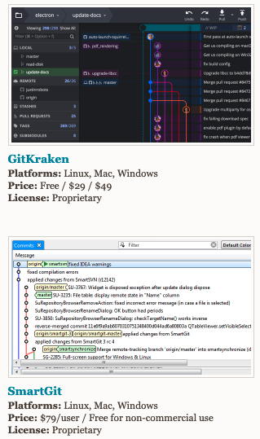

Slide 10
init
check-out
commit
branch
add
clone
status
pull
merge
push

Slide 11
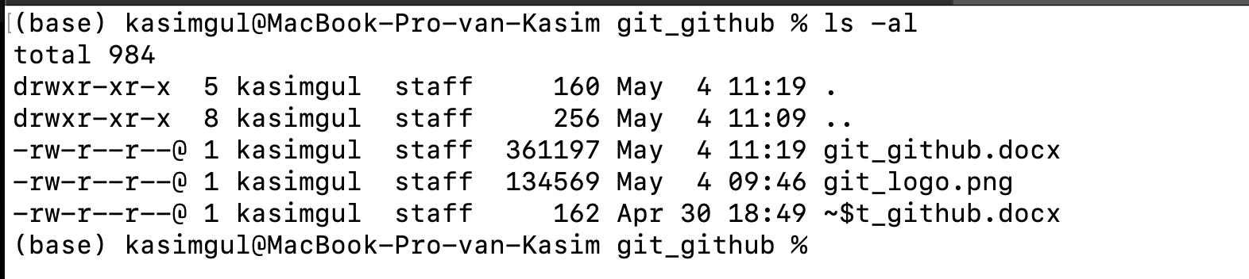
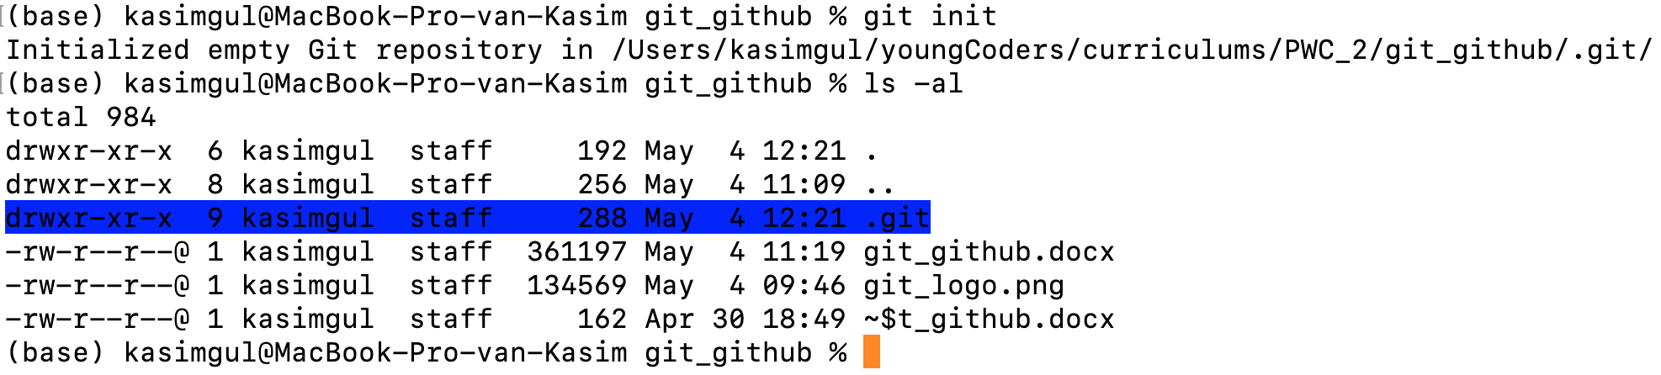

Slide 12
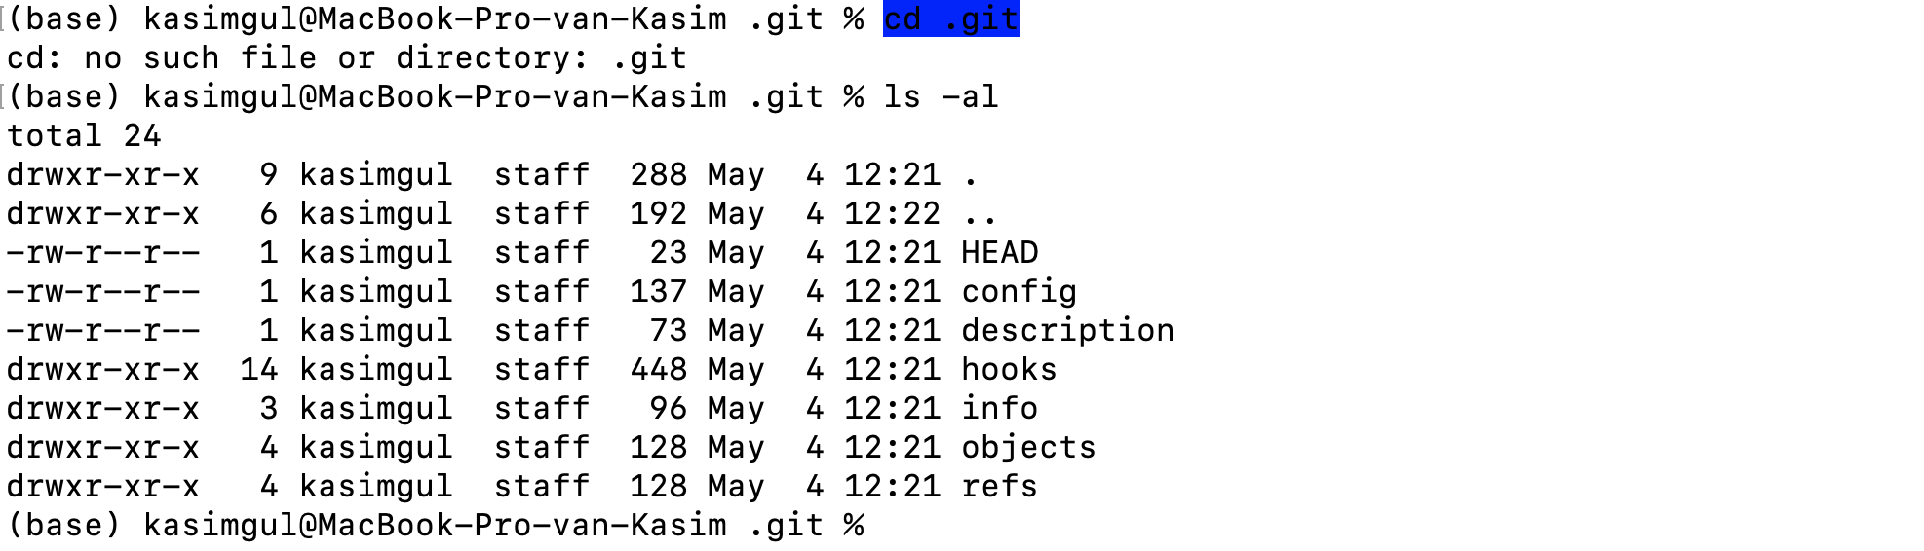

Slide 13
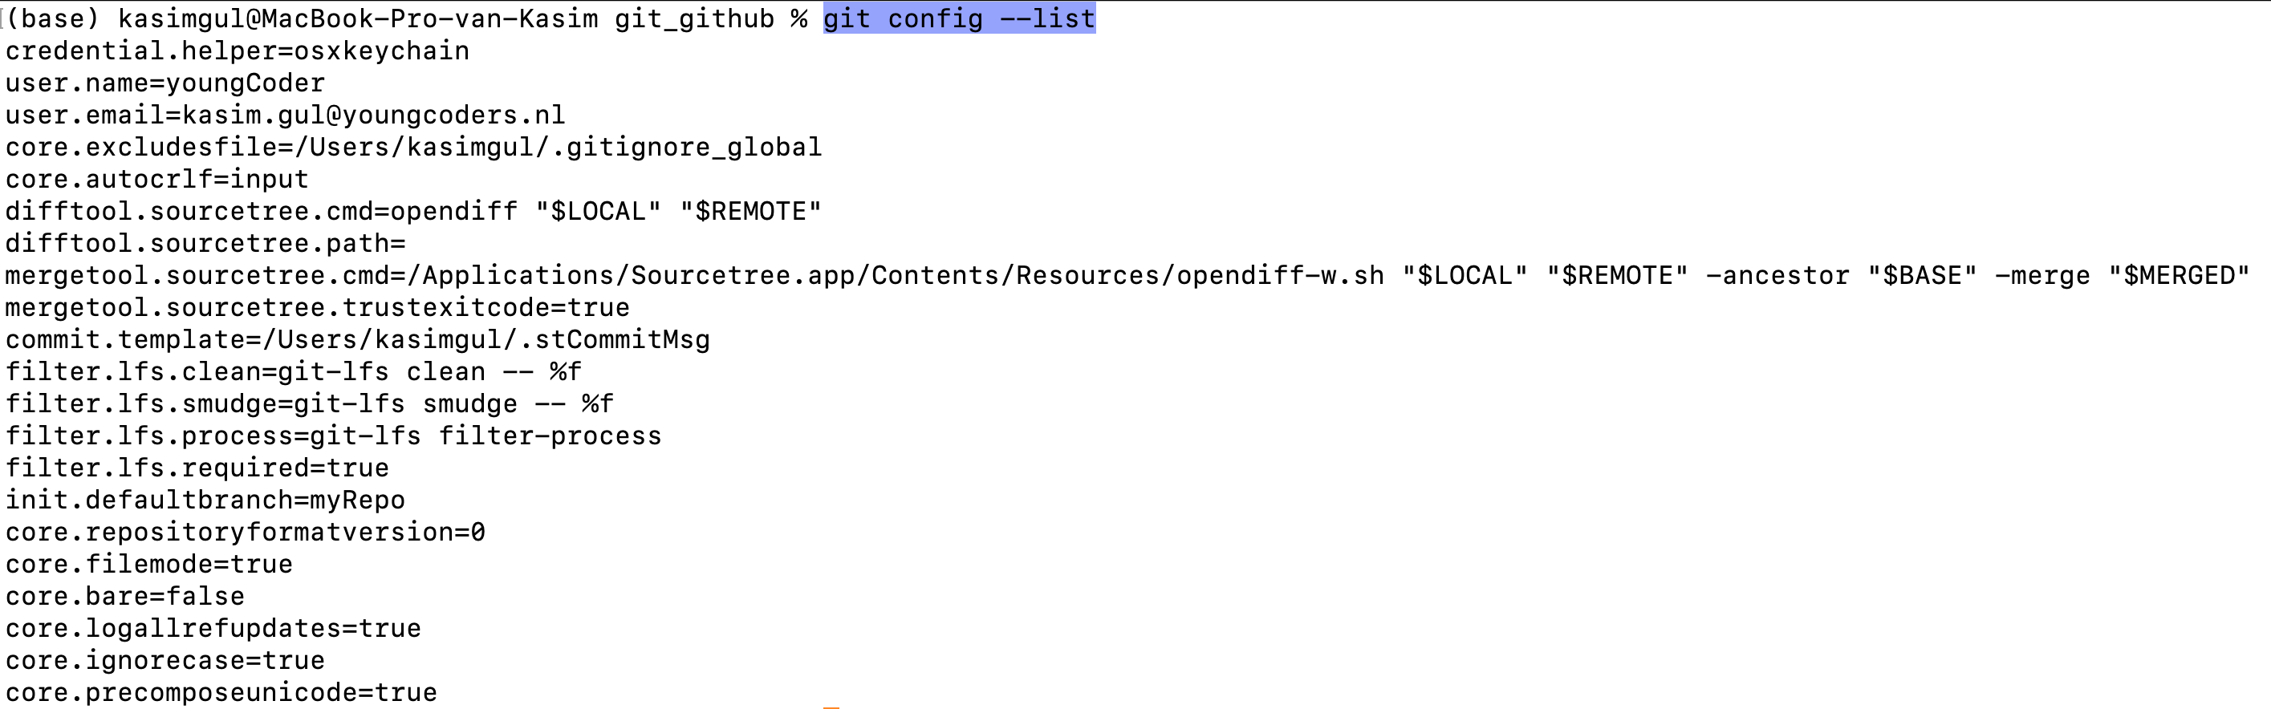
User name
User email
Repository name

Slide 14
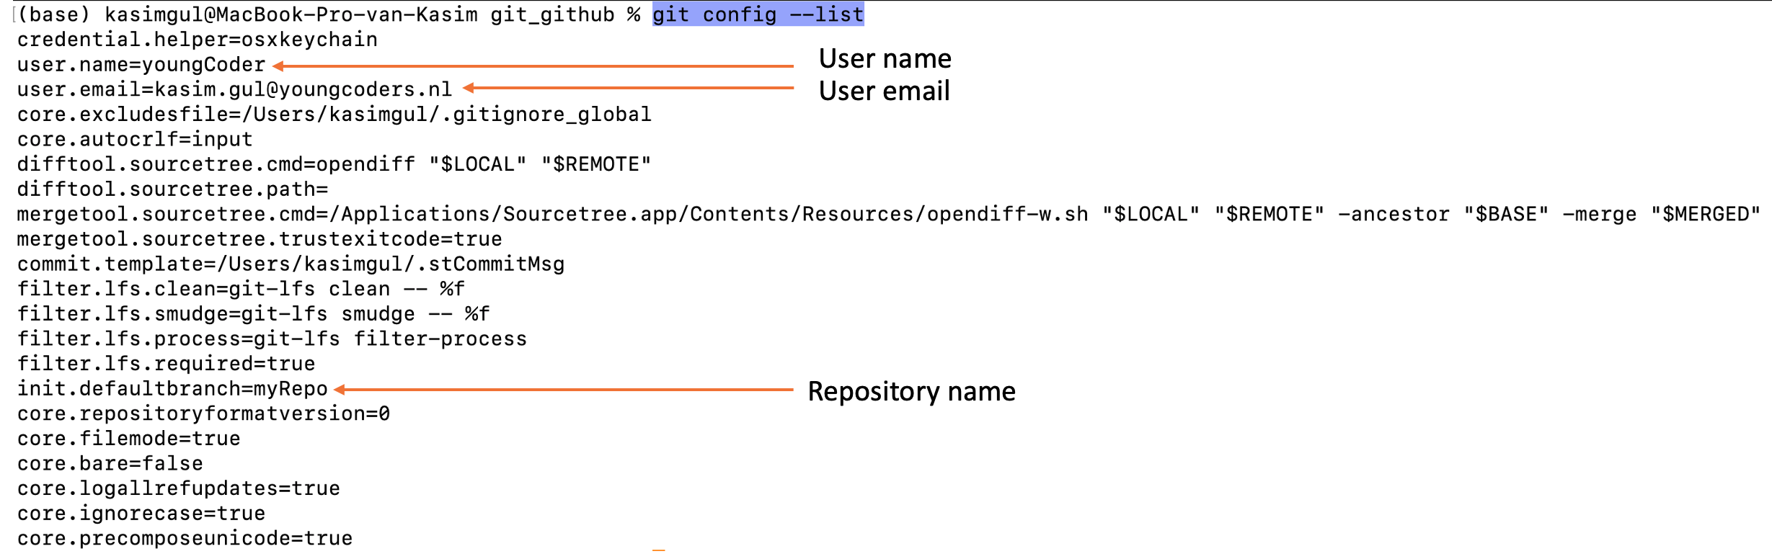
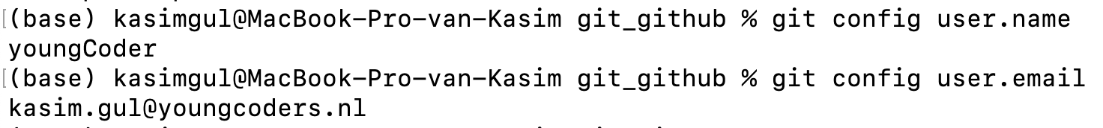

Slide 15
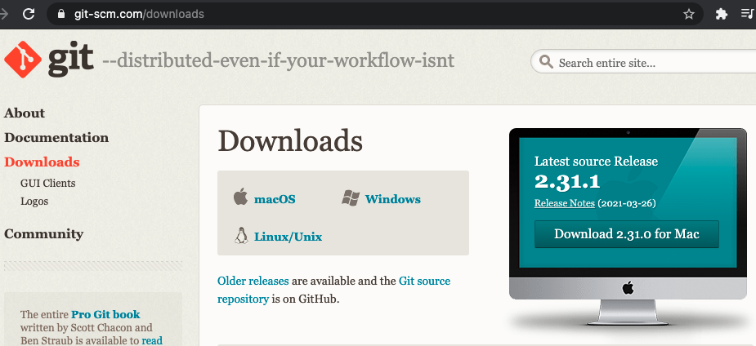

Slide 16
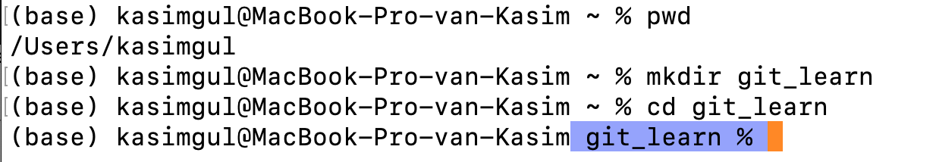
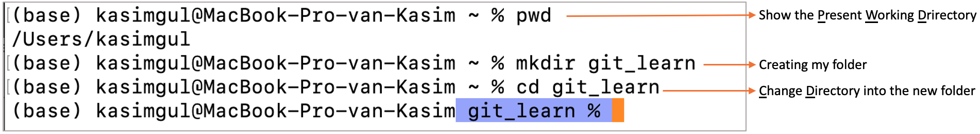
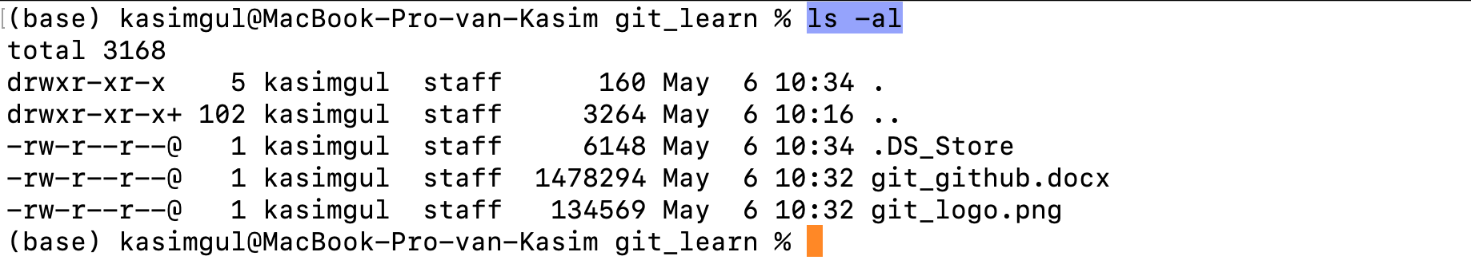
Show the Present Working Drirectory
Creating my folder
Change Directory into the new folder

Slide 17
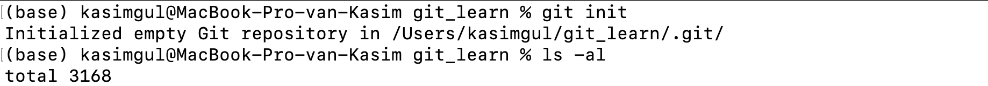
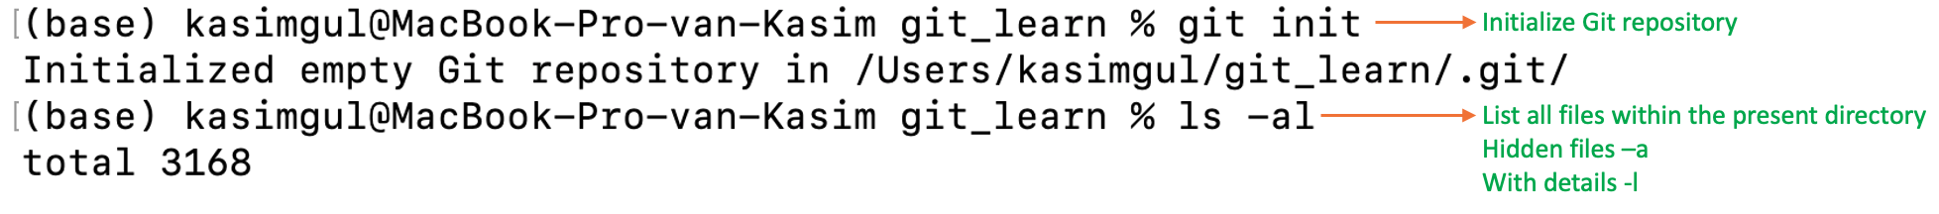
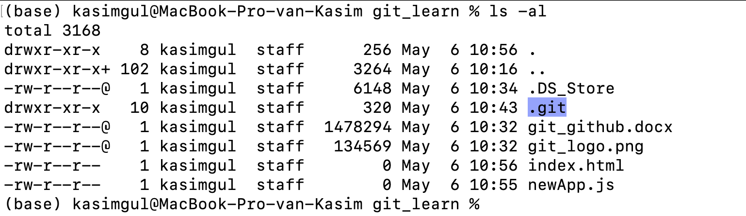
Initialize Git repository
List all files within the present directory
Hidden files –a
With details -l
The Git repository is created

Slide 18
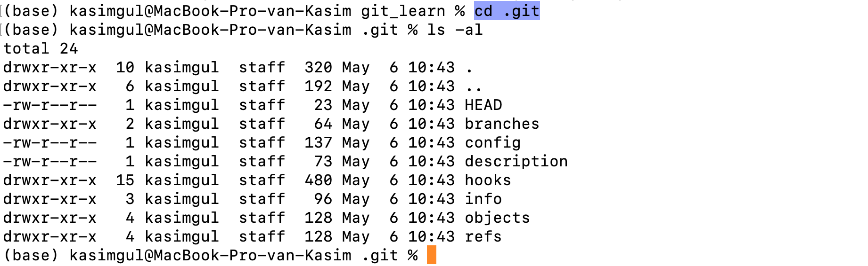

Slide 19
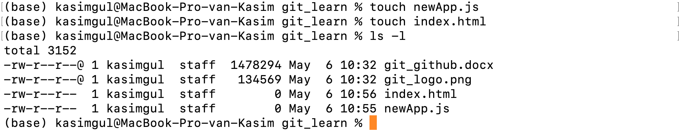
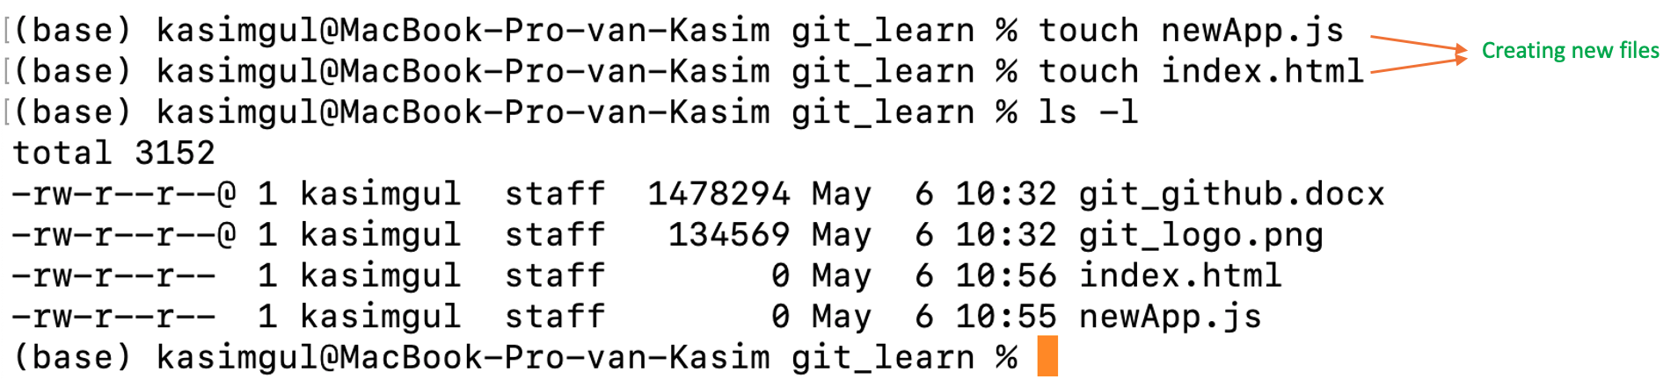
Creating new files

Slide 20
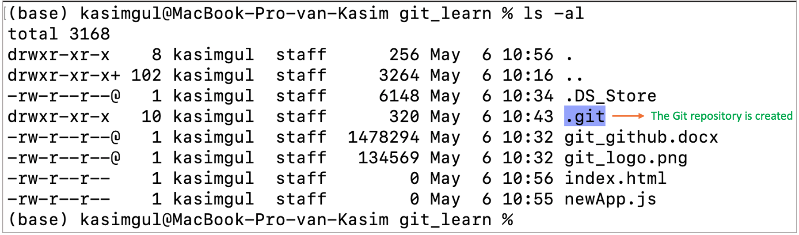

Slide 21
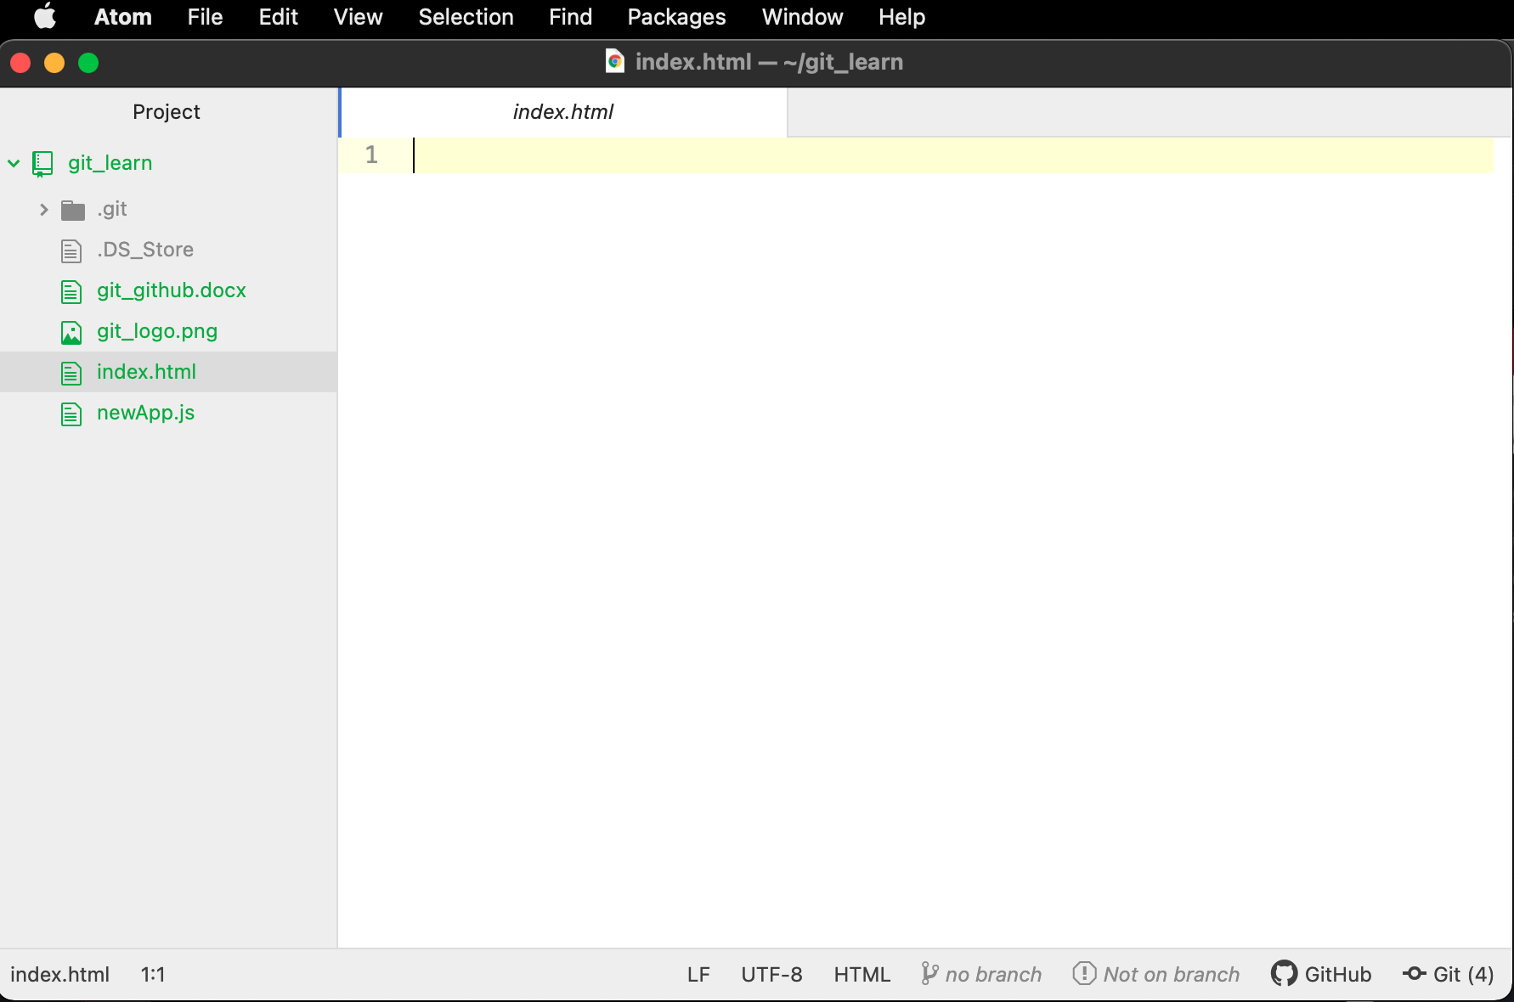

Slide 22
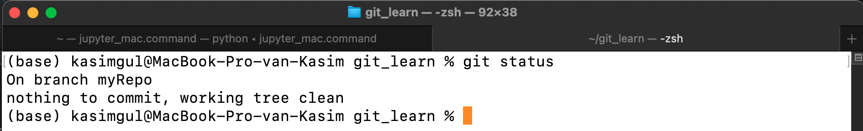
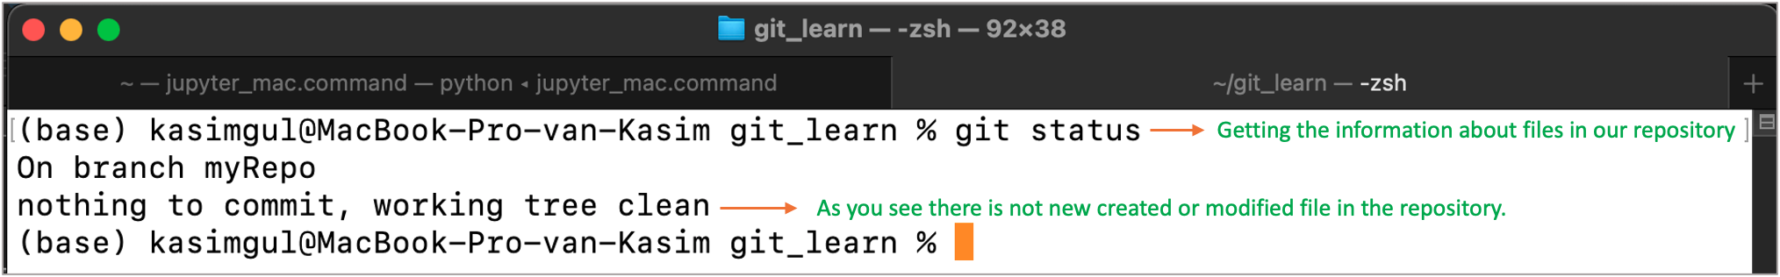
Getting the information about files in our repository
As you see there is not new created or modified file in the repository.

Slide 23
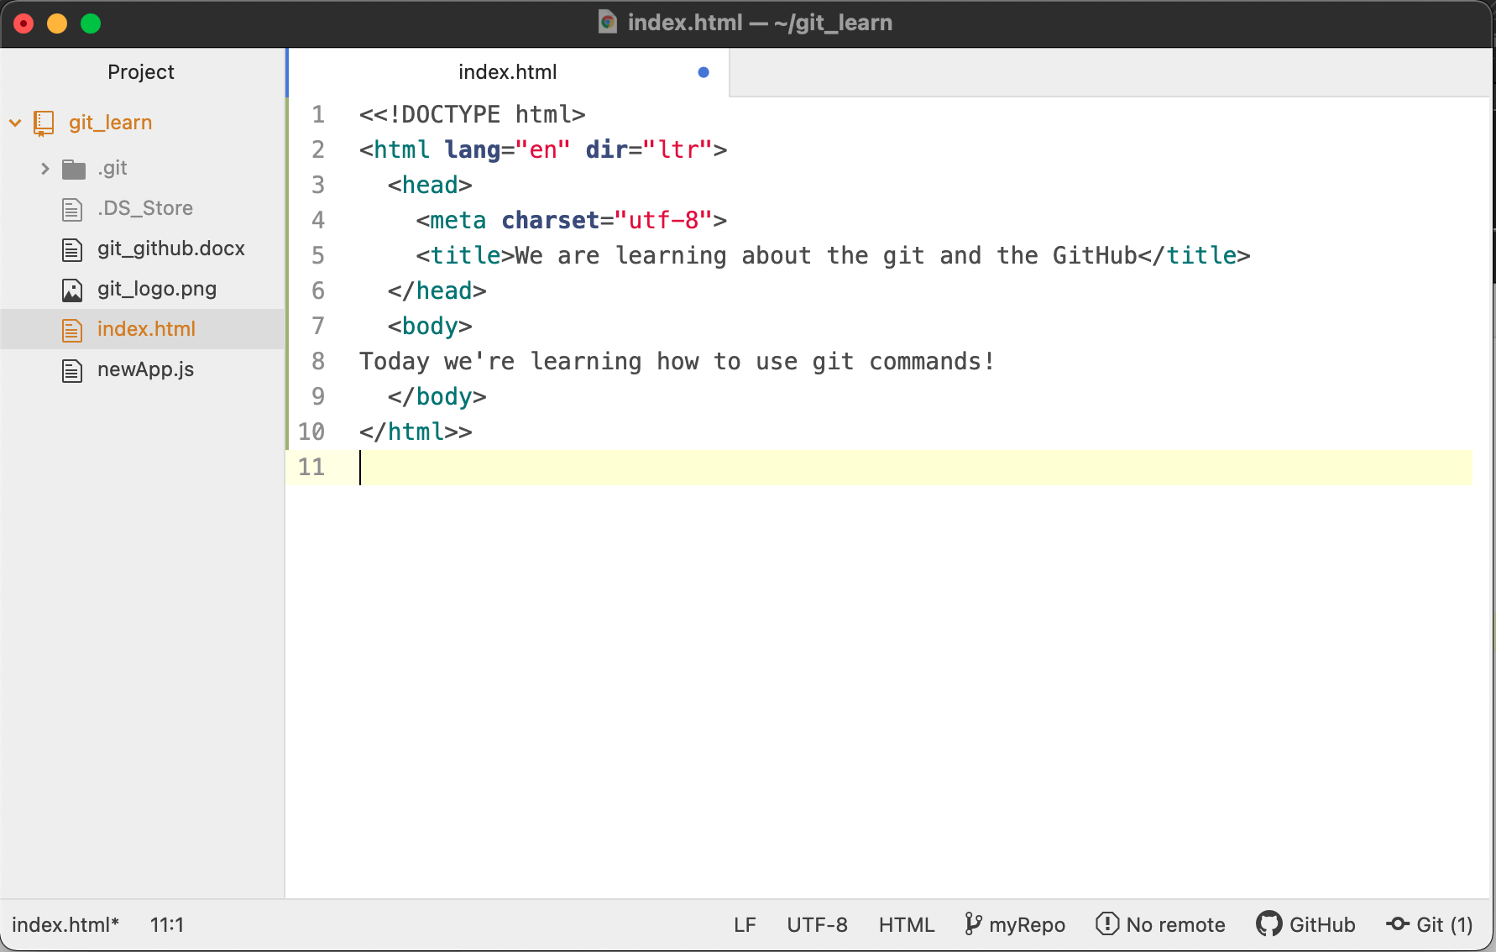

Slide 24
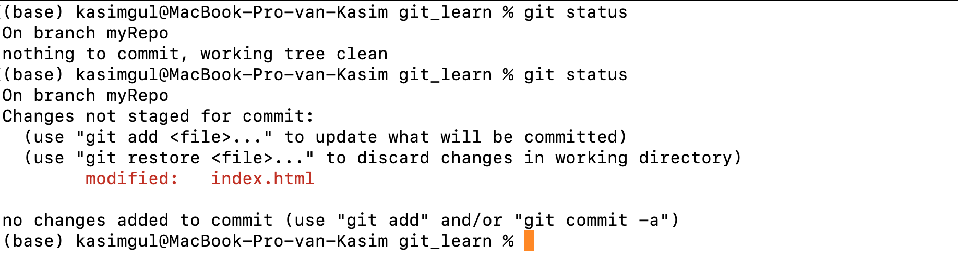
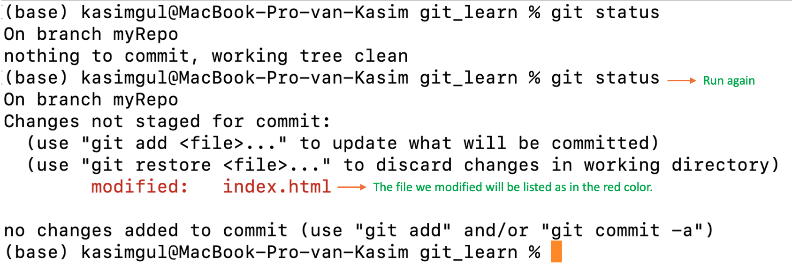
Run again
The file we modified will be listed as in the red color.

Slide 25
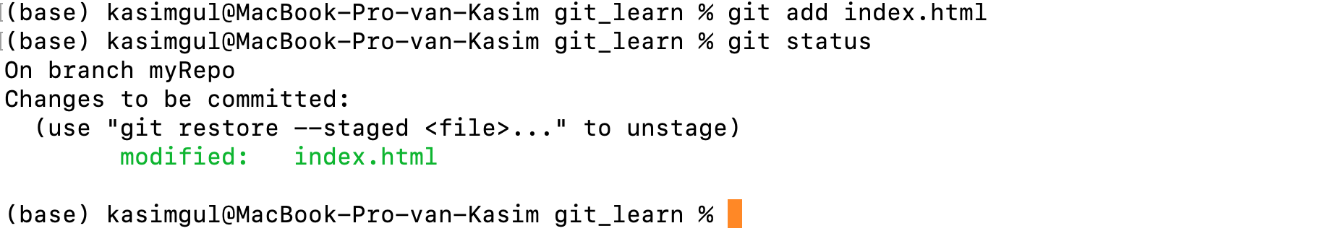
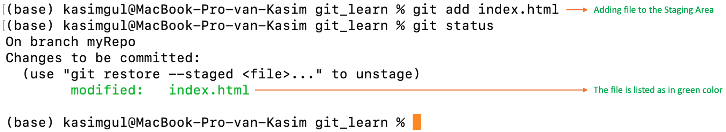
Adding file to the Staging Area
The file is listed as in green color

Slide 26
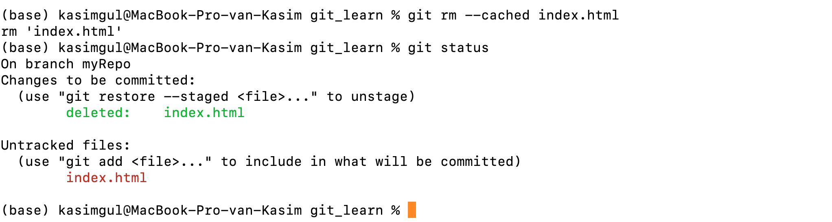
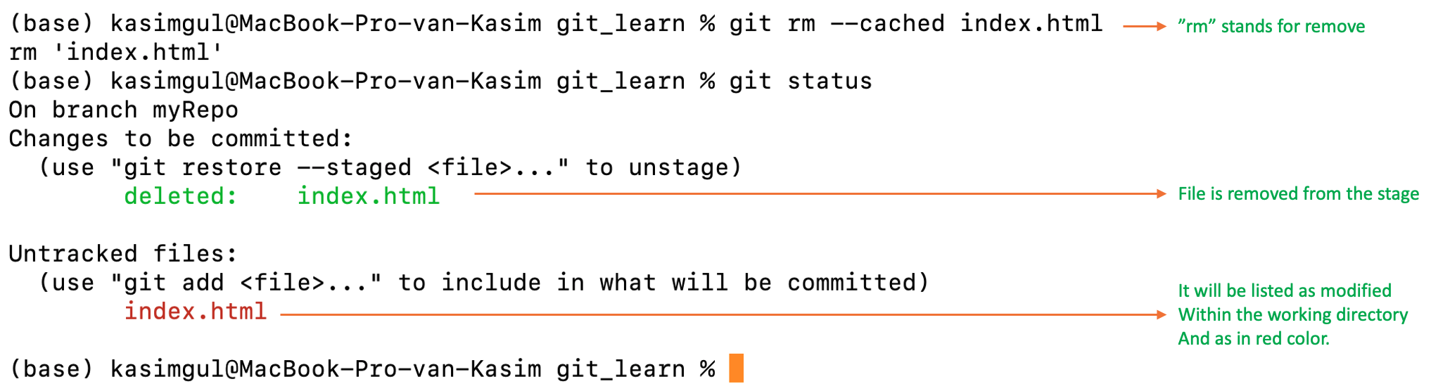
”rm” stands for remove
File is removed from the stage
It will be listed as modified
Within the working directory
And as in red color.

Slide 27
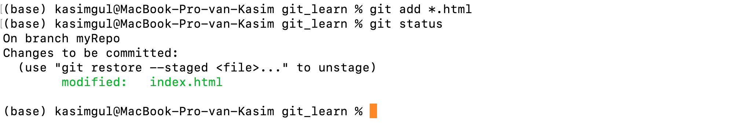
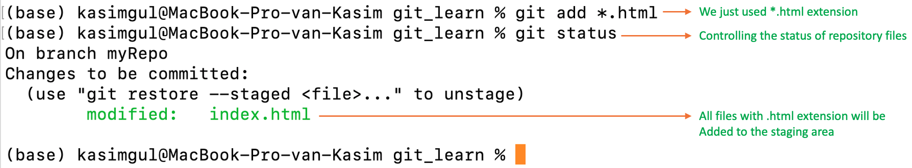
We just used *.html extension
Controlling the status of repository files
All files with .html extension will be
Added to the staging area

Slide 28
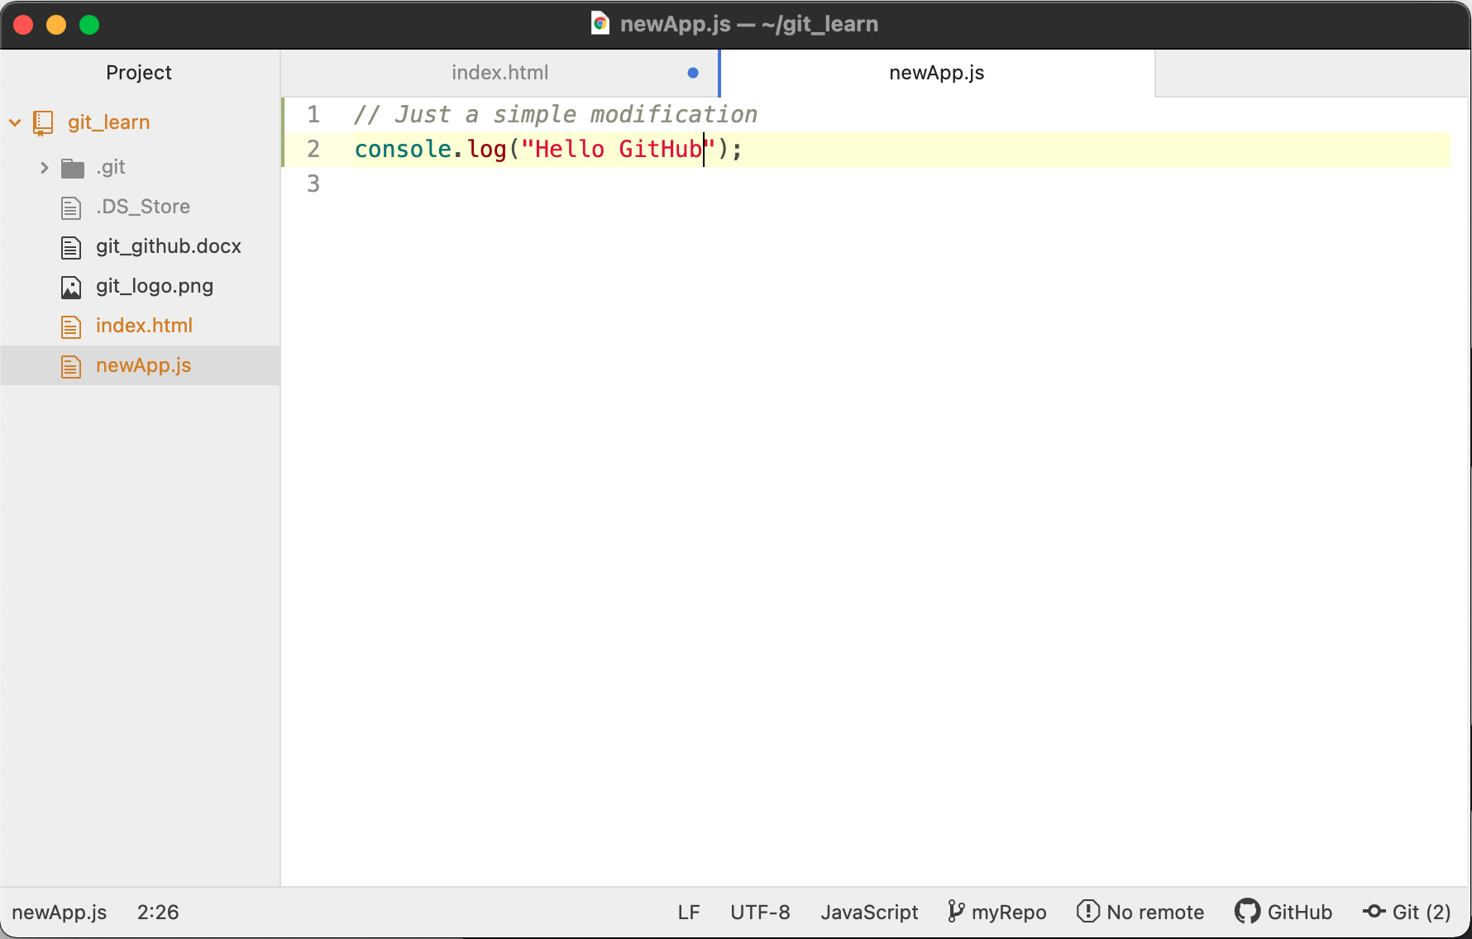

Slide 29
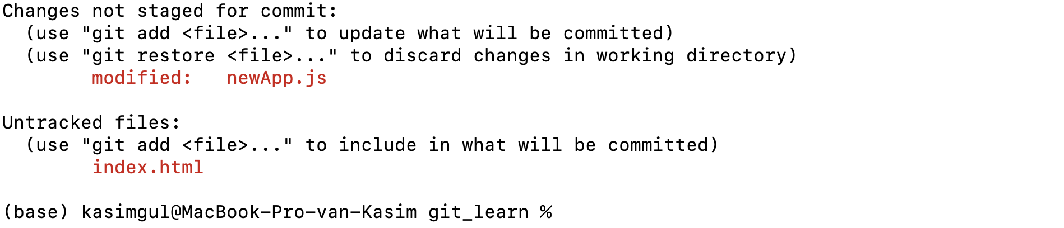
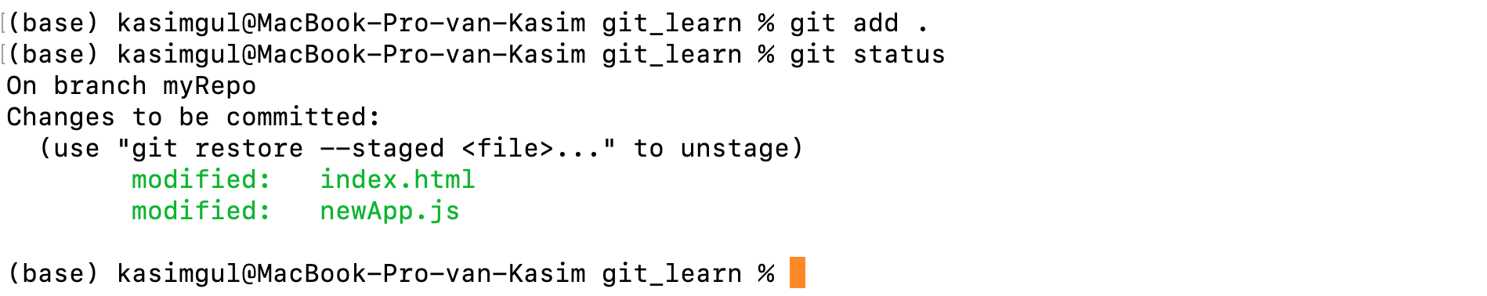

Slide 30
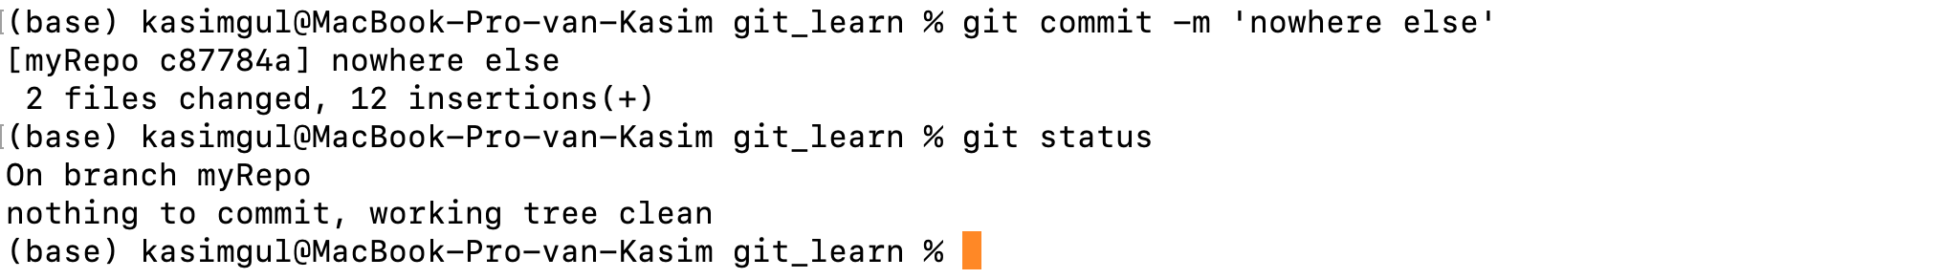
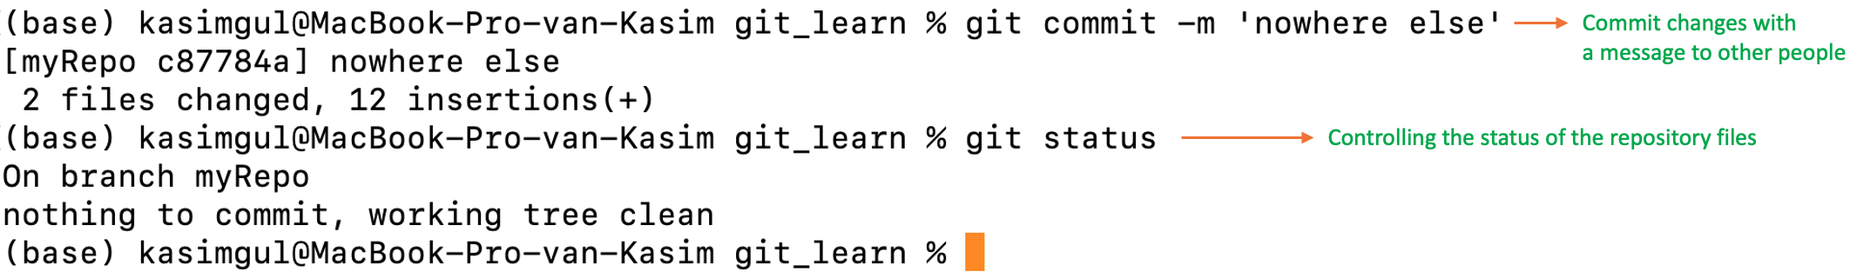
Commit changes with
a message to other people
Controlling the status of the repository files

Slide 31
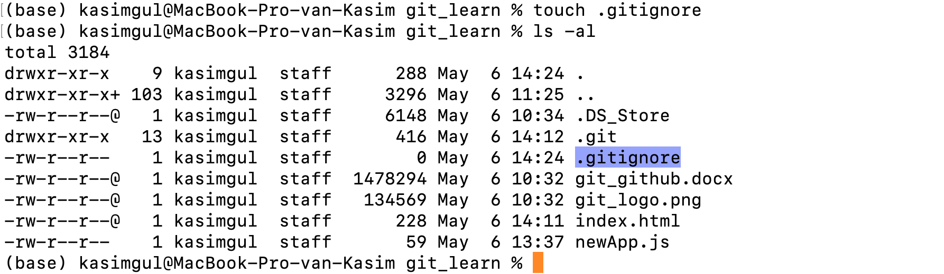

Slide 32
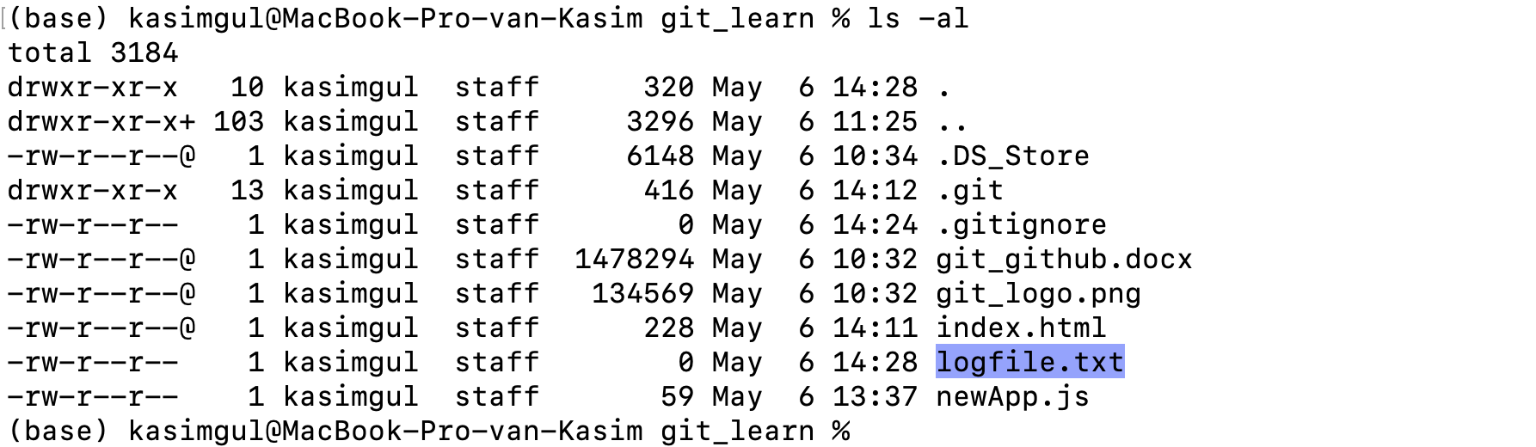

Slide 33
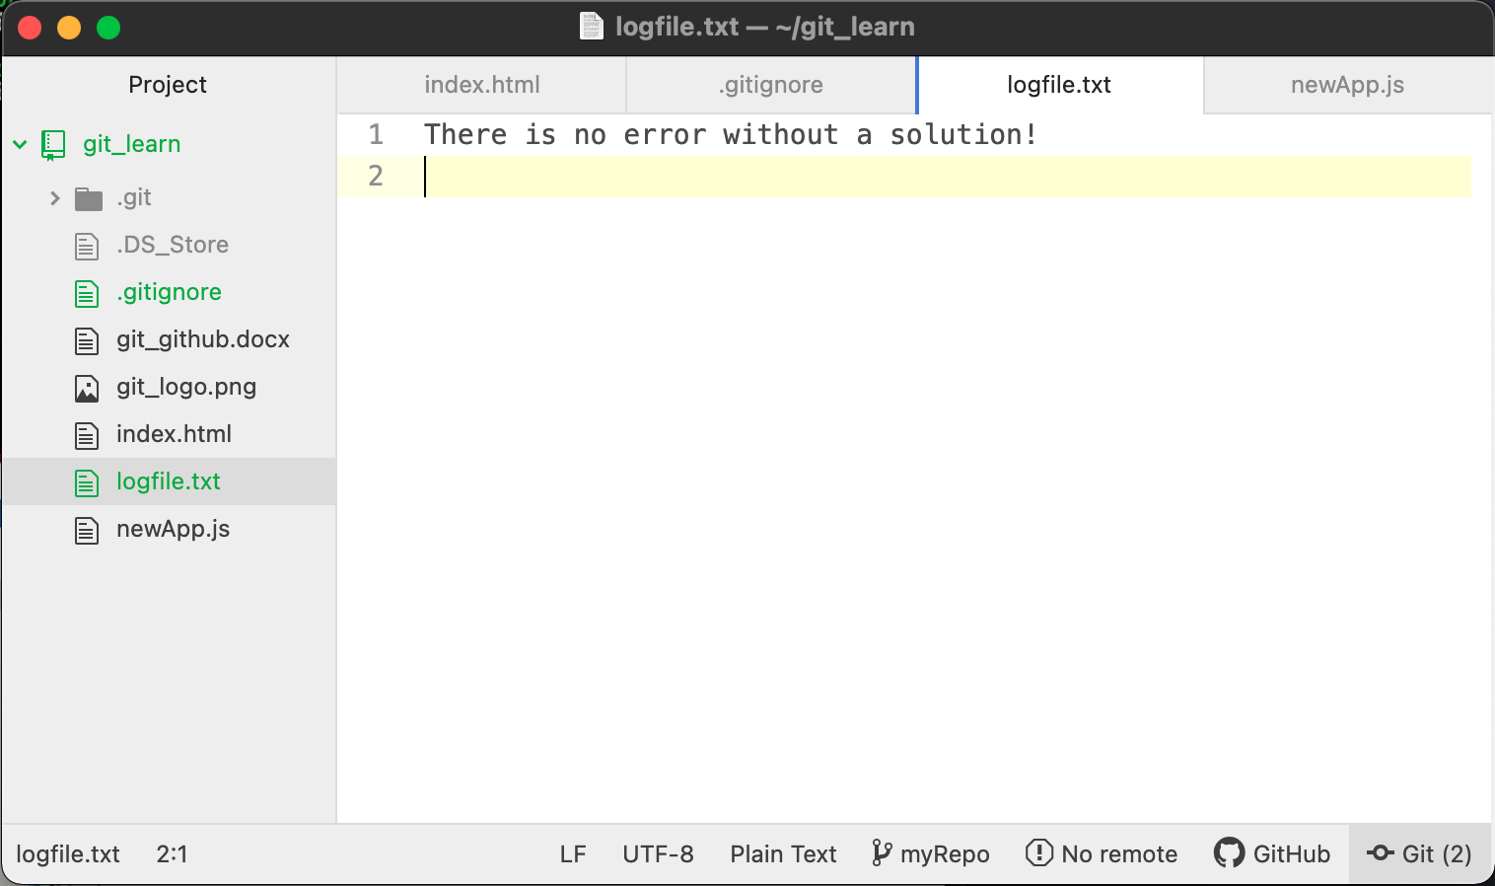

Slide 34
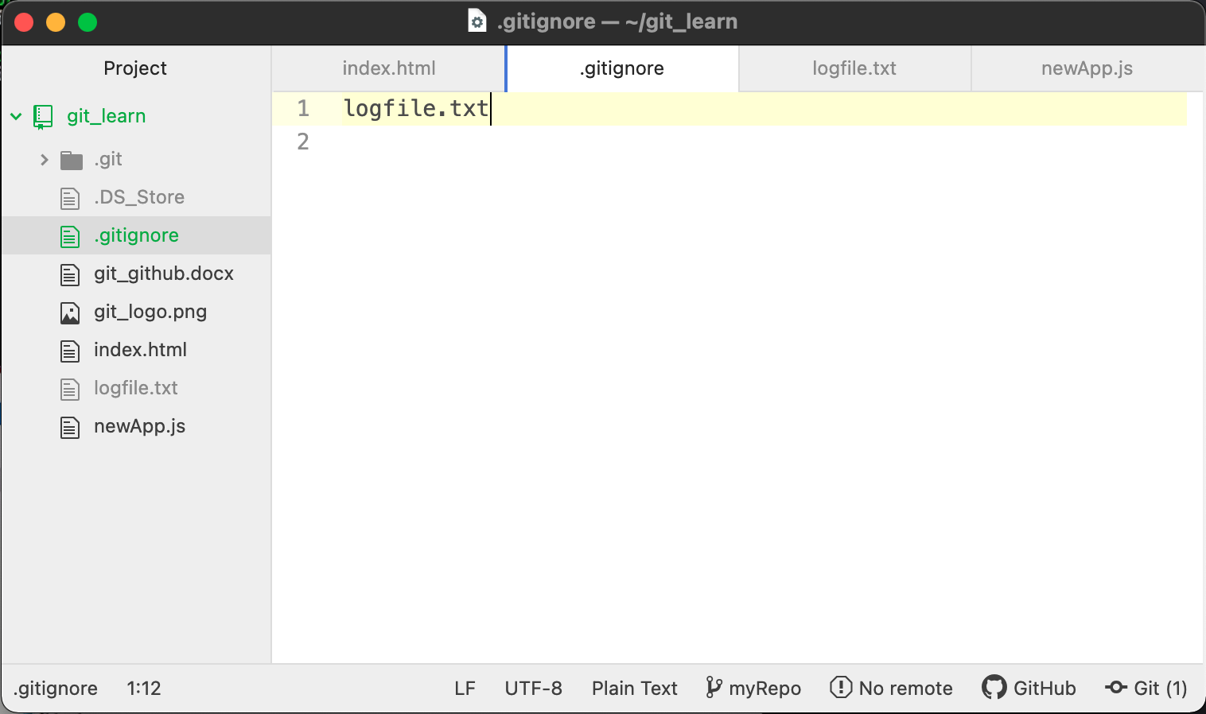

Slide 35
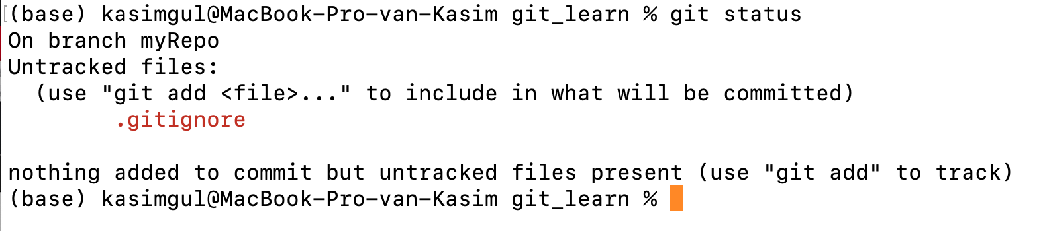

Slide 36
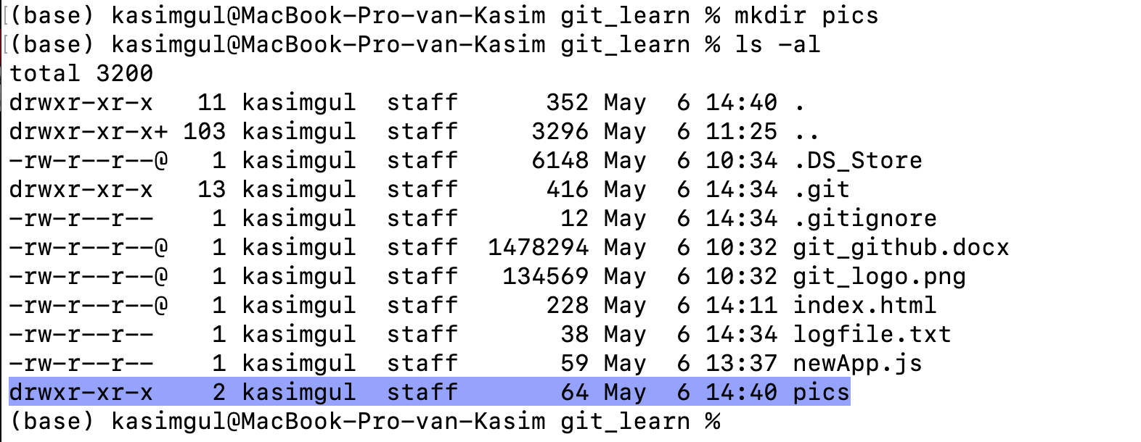

Slide 37
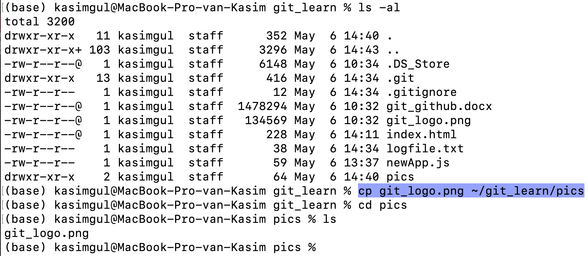

Slide 38
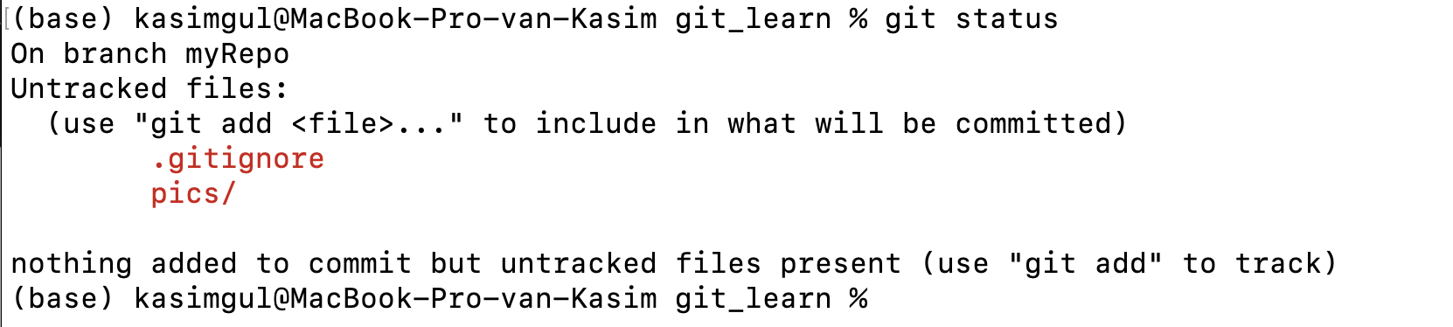

Slide 39
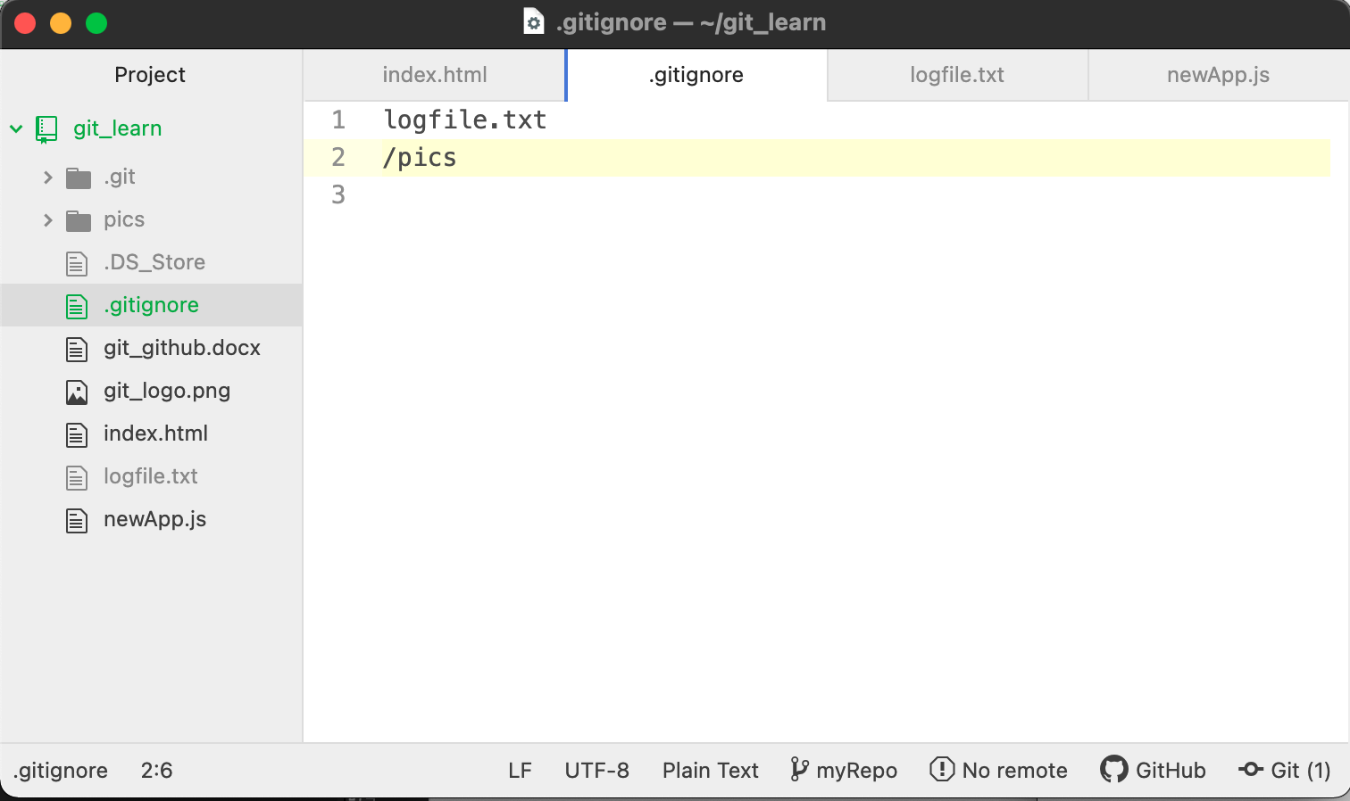

Slide 40
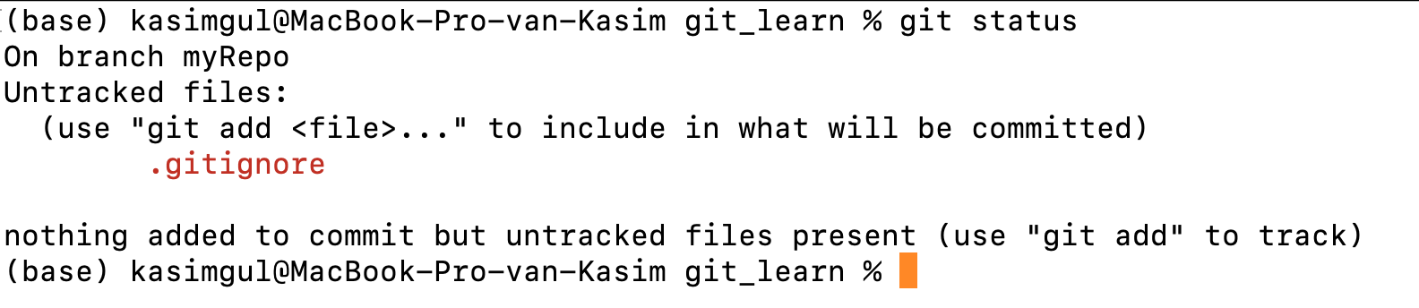

Slide 41


Create a new branch
Switch to new branch
Show the status of the present repository

Slide 42


Slide 43

Get the repository information
Only the new file will be committed
Add the file to the staging area
Commit changes

Slide 44


Slide 45



Slide 46


Switch to the “main” branch
login.html is not listed !

Slide 47


Merging two branches

Slide 48

Show the status of the repository branch
This file was created while we are in the “login_task” branch and it was not visible from the “main” branch before but now it is also listed.

Slide 49


Slide 50

Click me!

Slide 51


Slide 52


Slide 53

Give a name to your repository
Click to create your new repository

Slide 54


Slide 55

Your GitHub account name and the repository you are in
Remote repository URL
Explanations of how to use the Git with the GitHub

Slide 56


Slide 57
Setting the new remote repository URL as origin
Listing the existed remote repositories
git config -l | grep url
git remote rm origin
git remote add origin https://youngcoders2021@github.com/youngcoders2021/yCoders.git

Slide 58


Remote repository
The main branch
Uploaded files

Slide 59


Slide 60

Under the main branch
No README.md file yet
Click on to “Add a README” button.

Slide 61


Slide 62



Slide 63

Under the main branch
README.md is here!
It appears at the bottom
1 # used for bigger
2 # used
for smaller

Slide 64


Slide 65


Slide 66

Pulling (downloading) all committed remote repository files to our local repository
README.md is here!
Can you guess what are those +++++ signs for?

Slide 67


Slide 68


Slide 69

Create a new directory
List all with details
The new directory is created
Change Directory

Slide 70


Slide 71


Slide 72



Slide 73



Slide 74

New lines added!
“commit” below!

Slide 75


Slide 76


Slide 77


Slide 78
GIT Interview Questions & Answers

Slide 79


Slide 80


Slide 81


Slide 82


Slide 83


Slide 84


Slide 85


Slide 86


Slide 87


Slide 88


Slide 89


Slide 90


Slide 91


Slide 92


Slide 93


Slide 94


Slide 95


Slide 96


Slide 97


Slide 98


Slide 99


Slide 100


Slide 101

ssh-keygen -t rsa -C your_email@example.com
#replace your_email@example.com with your email address.
cat /home/master/.ssh/id_rsa.pub
Copy the public key text carefully starting from ssh-rsa and ending in your email address. This text will be used in the next step.
Log into your GitHub account and choose your desired repository (which you want to connect to your web application). Then, navigate to Settings and click on Deploy Keys.
Click on Add Deploy Key button to add the SSH key we copied in step 3. Paste the content into the Key field on GitHub. You can give a name to this key in the title field (e.g. Demo).
Check Allow write access option to give write access (push) to your repository
Click on Add Key button to save the SSH key.

